Slide 1



Super Store Product Diagnosis

Slide 2

Learning Objectives
To perform loading,cleaning and transformation of data using Power BI.
To learn how to create and customize various charts and advanced visualizations.
To modify chart colors,add visual box,shadow and change background color.
Learn how to use slicers and filters for creating interactive dashboards.
GOAL
Source :
www.freepik.com/

Slide 3
Tools and Technology used
Bar Charts are used to compare categories by placing data on the x and y axes.
Line Charts track changes over time to reveal trends.
Pie Charts represent parts of a whole, such as sales by region.
Treemaps use colored rectangles to compare data in a hierarchical structure.
Funnel Charts show the stages of a process, Cards display key figures.
Donut Charts show proportions with additional space for extra information.

Slide 4
Methodology
In the visualizations tab, begin by choosing the right chart to analyze your data.
Next, add data to the x-axis and y-axis to show how the variables relate.
You can apply filters to focus on specific data, like the top N points.
Customize the chart's look by changing colors and backgrounds.
Finally, create a dashboard to show all the charts on one page for a complete overview.

Slide 5
Problem Statement:
To analyze the superstore dataset and estimate the profit from the products sold.

Slide 6
Solution:
Analyzing the superstore dataset reveals new trends and insights, giving a clearer understanding of the data.
It allows businesses to evaluate sales in real-time and make quick decisions.
The dataset can also be updated with new data, improving analysis and boosting sales performance over time.

Slide 7
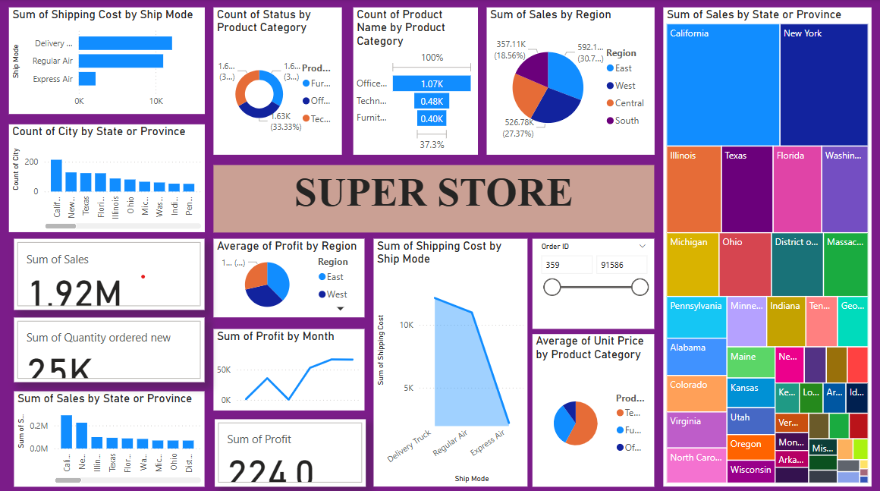
Screenshot of Output:

Slide 8
Conclusion:
Successfully imported,cleaned and transformed raw data using Power BI for analysis.
Created various charts and graphs such as bar chart, line chart,pie chart,donut chart,cards and treemaps.
Designed interactive dashboard for better understanding.

